Slide 1
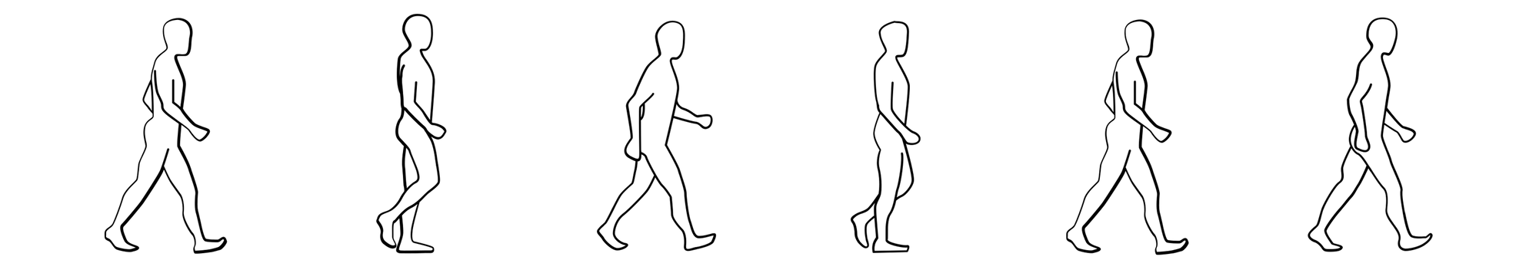
G21: Cruoglio Antonella - Iovino Giuliana - Mascolo Davide - Napoli Mario
September 14, 2022
Who's Walking?
Statistical Learning Project

Slide 2
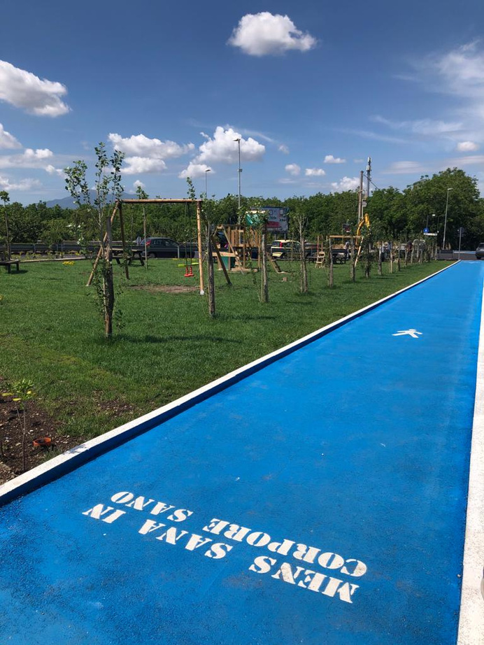
G21: Cruoglio Antonella - Iovino Giuliana - Mascolo Davide - Napoli Mario
September 14, 2022
The Goal
The goal of this project is to identify different subjects using accelerometer data from a smartphone that describe their walking patterns.
The identifier algorithm was trained and evaluated in an experiment with four human subjects including two males and two females
in real-world conditions.
Various classifiers were tested using descriptive statistical features.

Slide 3
G21: Cruoglio Antonella - Iovino Giuliana - Mascolo Davide - Napoli Mario
September 14, 2022
Our Work
1
2
3
4
5
Data Collection
Preprocessing Data Analysis
Model Training
Interpretation
of Results
Unsupervised
Approach

Slide 4

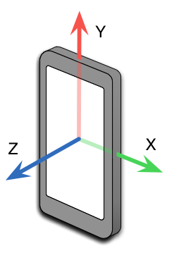
G21: Cruoglio Antonella - Iovino Giuliana - Mascolo Davide - Napoli Mario
September 14, 2022
Data Collection
In order to collect data, we use the ‘Arduino Science Journal’ app to record data from a triaxial accelerometer to measure acceleration.
We got four .csv files, one for each group member. Each .csv file contains the values of:
- Relative time (in milliseconds)
- Linear accelerometer sensor
- Acceleration on the x axis
- Acceleration on the y axis
- Acceleration on the z axis

Slide 5
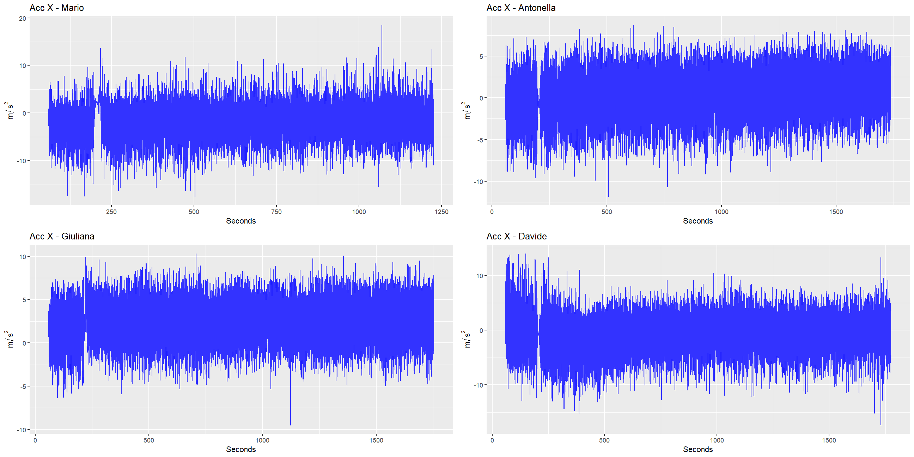
G21: Cruoglio Antonella - Iovino Giuliana - Mascolo Davide - Napoli Mario
September 14, 2022

Slide 6
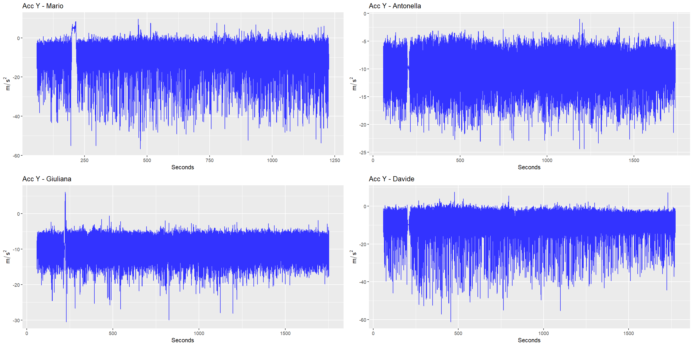
G21: Cruoglio Antonella - Iovino Giuliana - Mascolo Davide - Napoli Mario
September 14, 2022

Slide 7
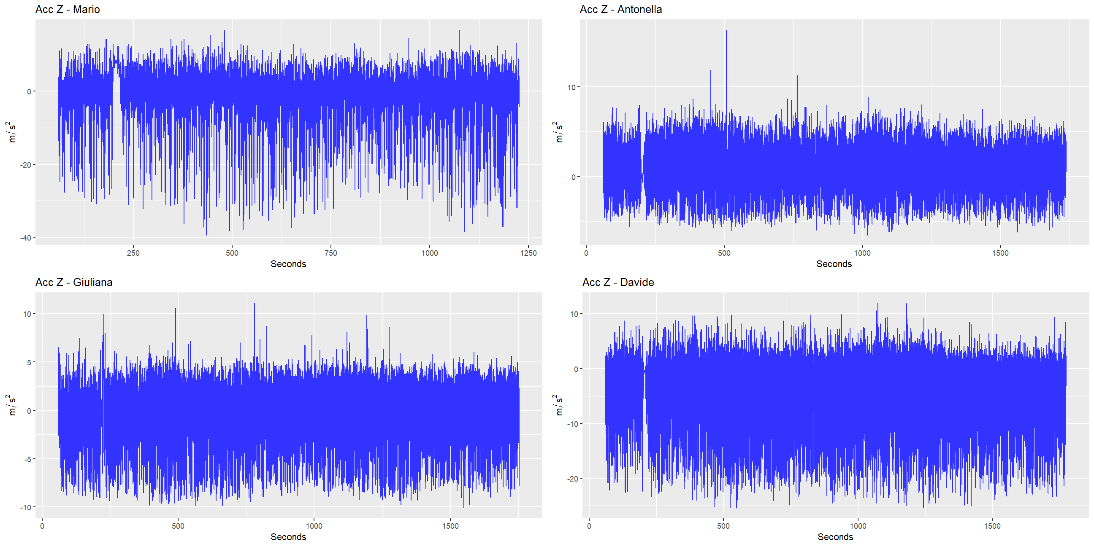
G21: Cruoglio Antonella - Iovino Giuliana - Mascolo Davide - Napoli Mario
September 14, 2022

Slide 8
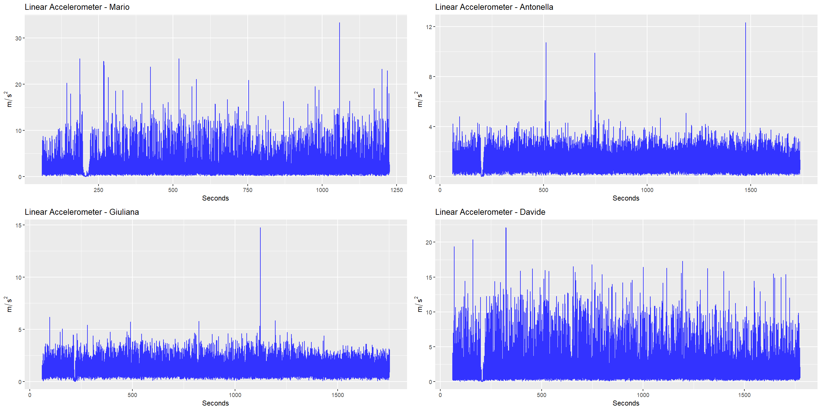
G21: Cruoglio Antonella - Iovino Giuliana - Mascolo Davide - Napoli Mario
September 14, 2022

Slide 9

G21: Cruoglio Antonella - Iovino Giuliana - Mascolo Davide - Napoli Mario
September 14, 2022
Data Preparation
For this kind of data, it is necessary to do some pre-preprocessing operations, because it's not possible to use the raw-data signal to the classical classifiers.
- Removal of the first and the last minute of the registrations.
- Windowing with Overlapping

Slide 10

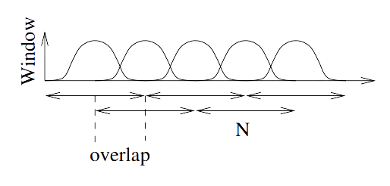
Windowing
With Overlapping
With this technique we divide the dataset
into smaller sets, in order to create new features.
Individual windows may overlap in time in order to reduce the loss of information at the edges of the window;
the overlap between windows is set to be at 50%.

Slide 11
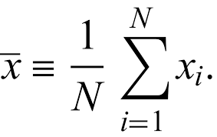
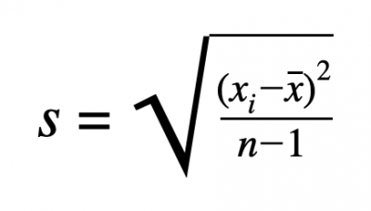
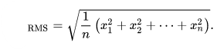
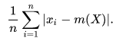
G21: Cruoglio Antonella - Iovino Giuliana - Mascolo Davide - Napoli Mario
September 14, 2022
New Features
We propose to extract the following features:
1
Mean of the Acceleration
These statistics are computed on each of the three axes (X, Y and Z).
So we obtain a total of 12 variables.
2
Standard Deviation of the Acceleration
3
Root Mean Square of the Acceleration
4
Absolute Difference of the Acceleration

Slide 12
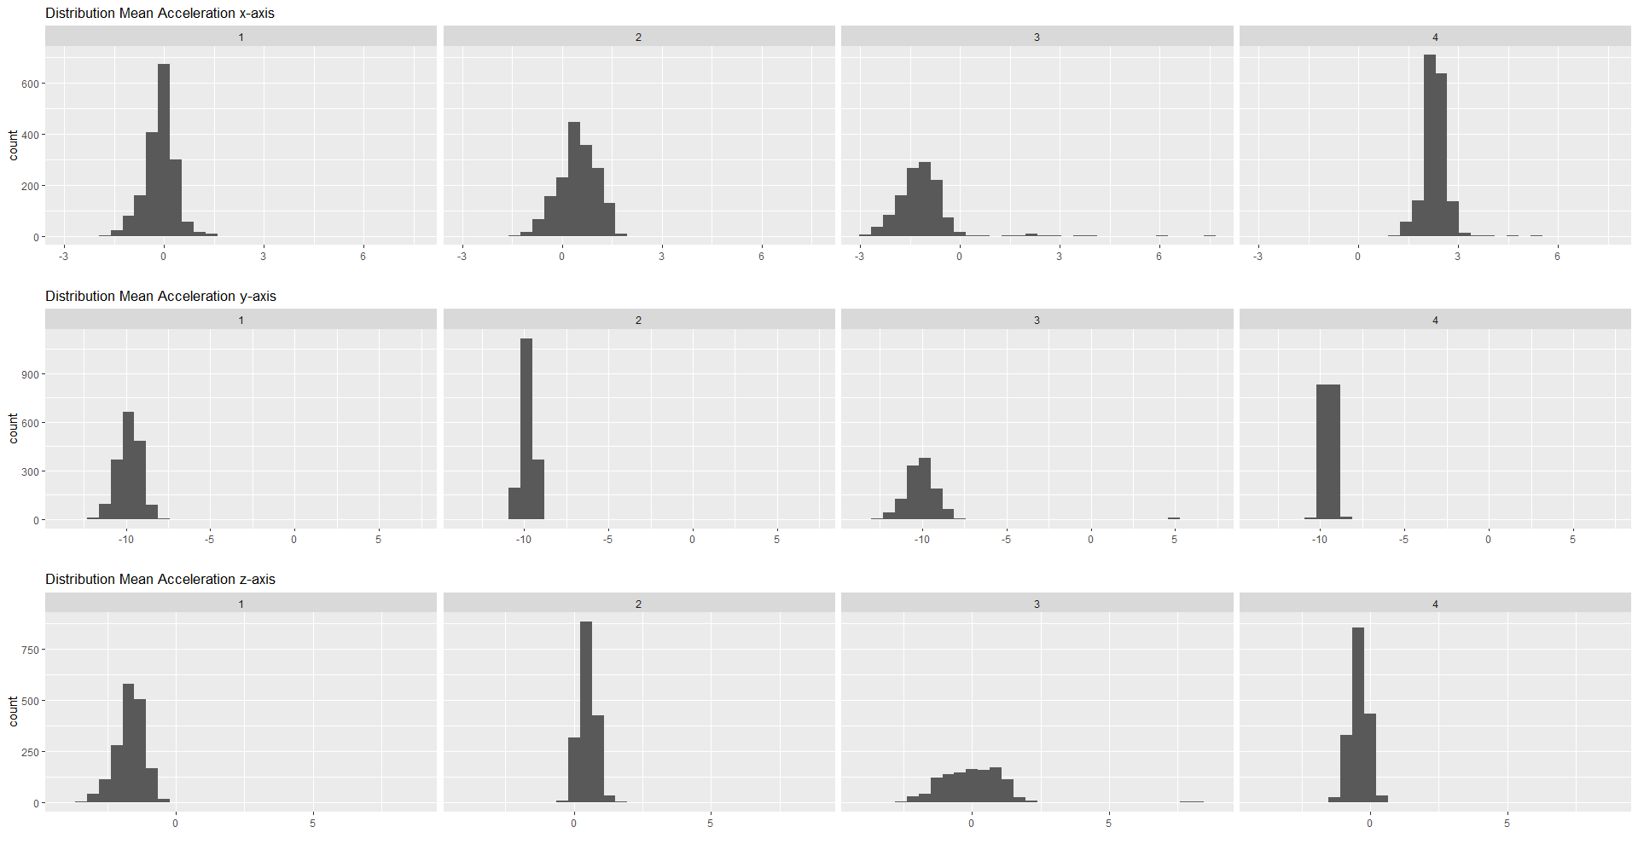
G21: Cruoglio Antonella - Iovino Giuliana - Mascolo Davide - Napoli Mario
September 14, 2022

Slide 13
The Models
Linear
Discriminant
Analysis
Support
Vector
Machine
Multinomial
Logit
K-Nearest
Neighbor
Random
Forest

Slide 14

G21: Cruoglio Antonella - Iovino Giuliana - Mascolo Davide - Napoli Mario
September 14, 2022
Validation Method
Split the data into Train (80%) and Test (20%)
Preserving the distribution of the outcome.
K-Fold Cross Validation with K = 5, to find the best hyperparameters.
For Random Forest mtry = p where p = number of features and ntree = 500.
Evaluation score: Accuracy

Slide 15
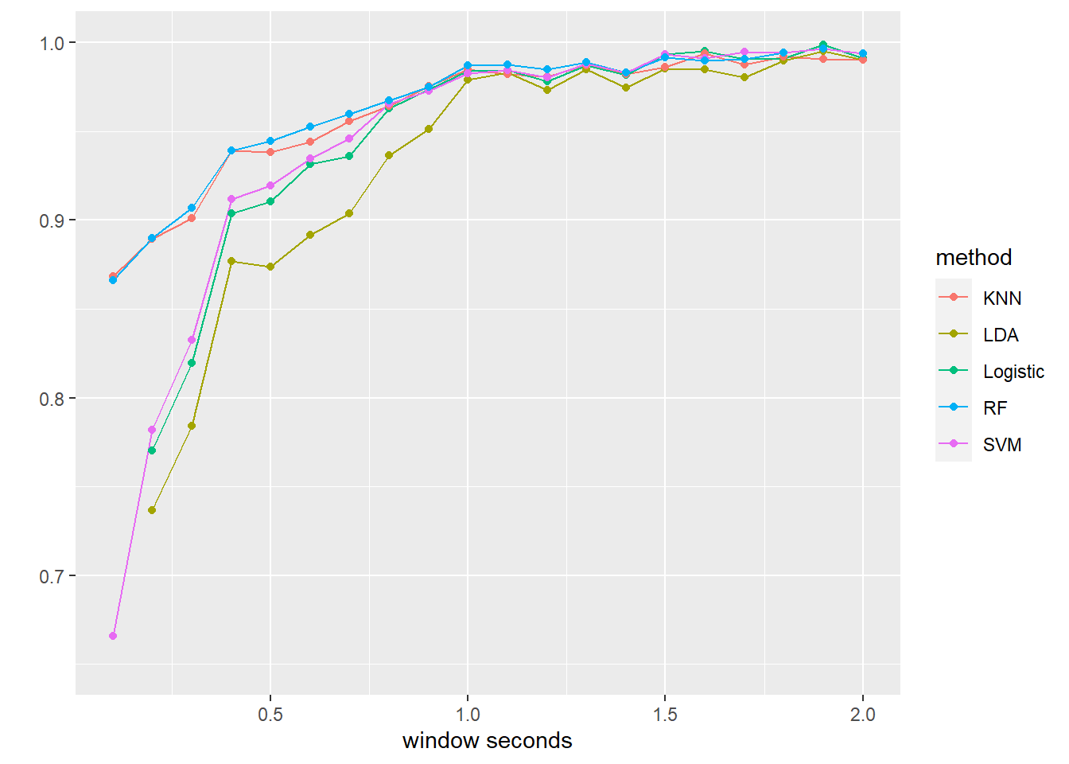
G21: Cruoglio Antonella - Iovino Giuliana - Mascolo Davide - Napoli Mario
September 14, 2022
Window Size
The window size is an important parameter to choose.
For this reason, we did a grid search on it, in order to find the most performing size.
Starting from 0.1 sec to 2 sec, with a step equal to 0.1 sec.

Slide 16
G21: Cruoglio Antonella - Iovino Giuliana - Mascolo Davide - Napoli Mario
September 14, 2022
It’s clear that increasing the window size we get a better performance.
In particular, the accuracy is increasing until 1 sec, then it becomes stable around 0.99.
At the end, we decided to use a window that corresponds to 1.28 seconds.
The reason is that this window can adequately represent cycles in walking activity.

Slide 17
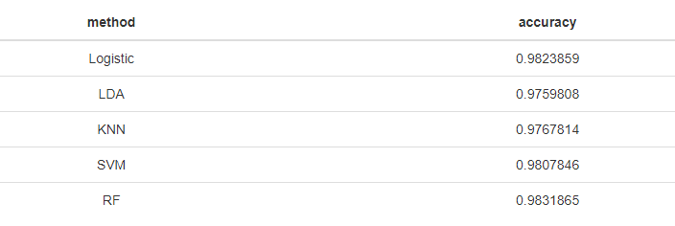

G21: Cruoglio Antonella - Iovino Giuliana - Mascolo Davide - Napoli Mario
September 14, 2022
Models comparison

Slide 18
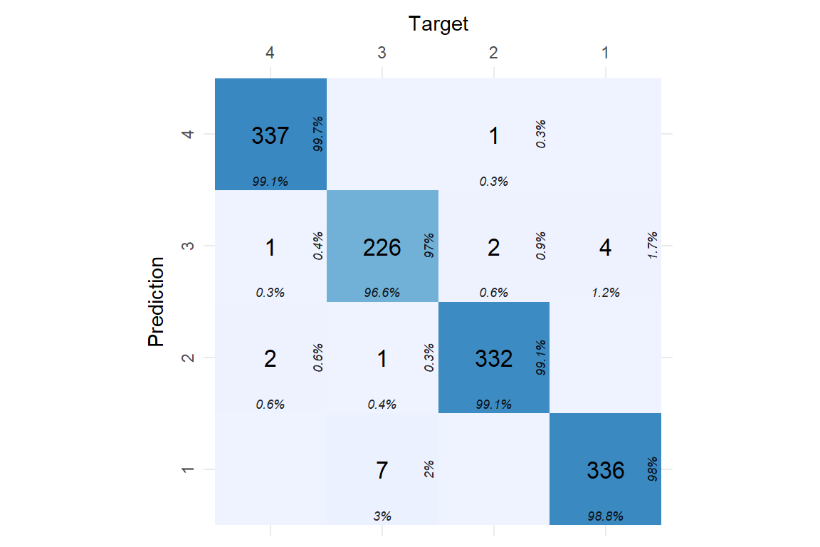
G21: Cruoglio Antonella - Iovino Giuliana - Mascolo Davide - Napoli Mario
September 14, 2022
Random Forest!
The best model seems to be Random Forest
With an accuracy of 0.98
The model is able to classify very well
but has difficulty distinguishing between class 1 and class 3 (Davide and Mario)

Slide 19
G21: Cruoglio Antonella - Iovino Giuliana - Mascolo Davide - Napoli Mario
September 14, 2022
Machine learning models usually perform really well for predictions, but are not interpretable.
We decided to implement different IML techniques to explain the Random Forest model.
IML

Slide 20
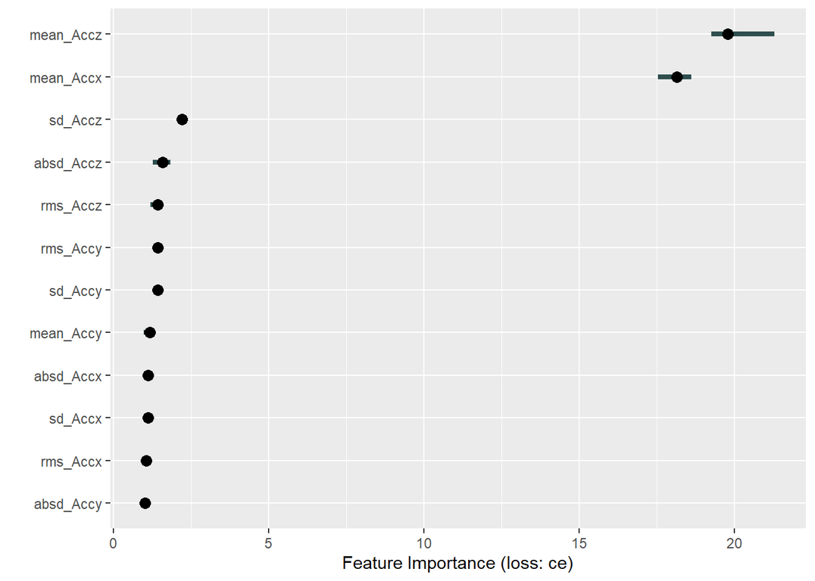
G21: Cruoglio Antonella - Iovino Giuliana - Mascolo Davide - Napoli Mario
September 14, 2022
Features Importance
The feature importance measure works by calculating the increase of the model’s prediction error after permuting the feature.
A feature is “important” if permuting its values increases the model error, because the model relied on the feature for the prediction.
A feature is “unimportant” if permuting its values keeps the model error unchanged, because the model ignored the feature for the prediction.
As we can see looking at the plot, the most important features are:
Mean Accelerometer x-axis
Mean Accelerometer z-axis
and others statistics computed on
z- accelerometer

Slide 21
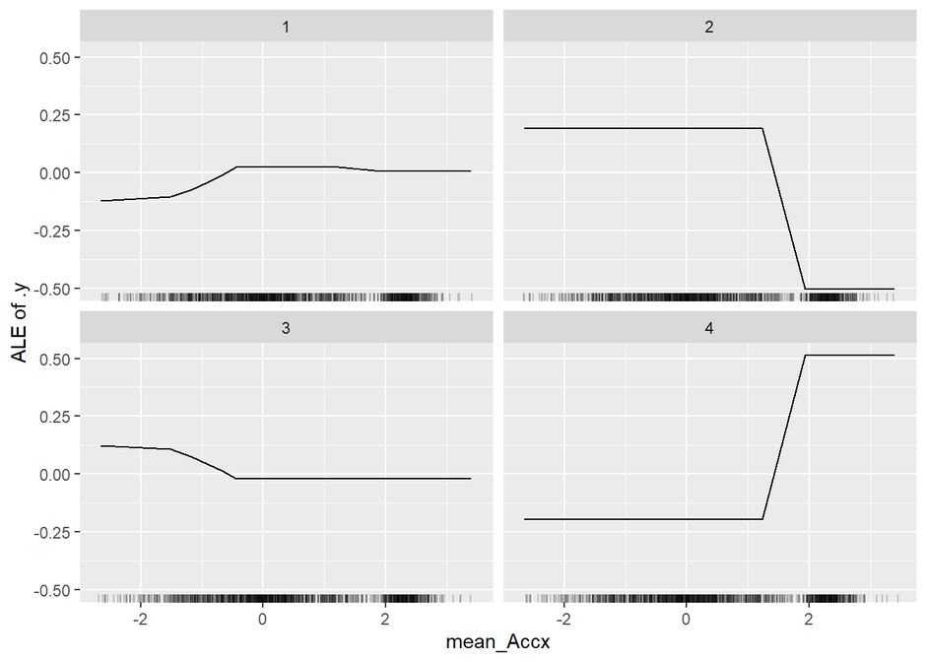
G21: Cruoglio Antonella - Iovino Giuliana - Mascolo Davide - Napoli Mario
September 14, 2022
ALE Plots
ALE shows how the prediction changes locally, when the feature is varied. The marks on the x-axis indicates the distribution of the feature, showing how relevant a region is for interpretation.
The Mean Acceleration on the x-axis is more relevant for the classification of class 2 and 4.

Slide 22
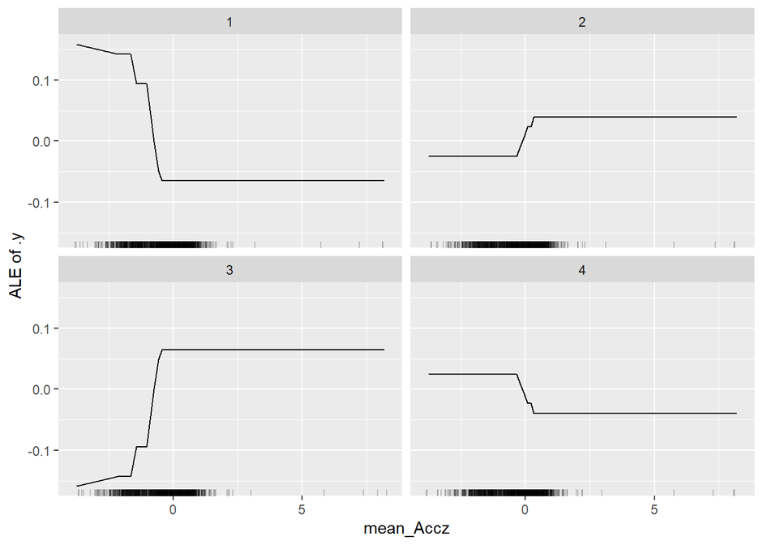
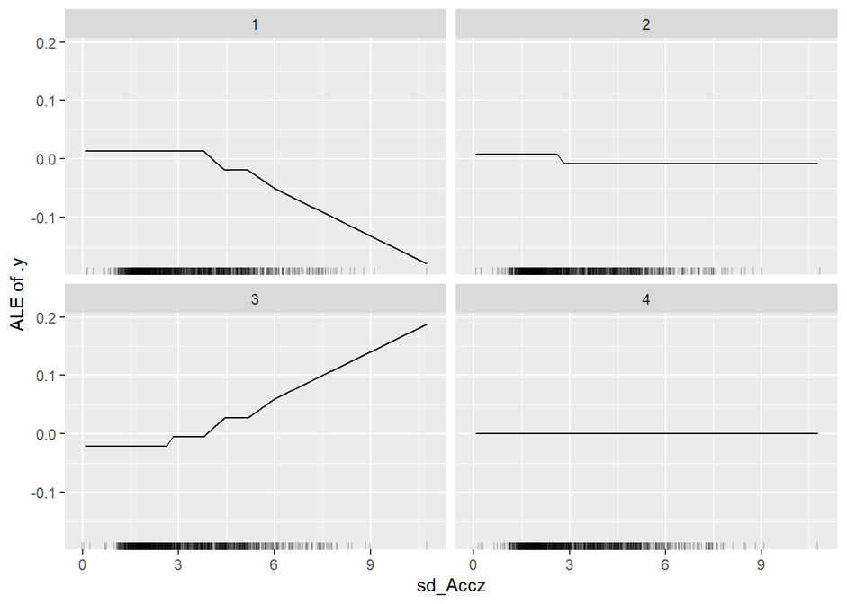
G21: Cruoglio Antonella - Iovino Giuliana - Mascolo Davide - Napoli Mario
September 14, 2022
The Mean Acceleration on the z-axis is more relevant for the classification of class 1 and 3.
In fact, as we can see from the plot, for these classes we have a greater variation with respect to the other two classes.
This happens also for the Standard Deviation on the same axis.

Slide 23
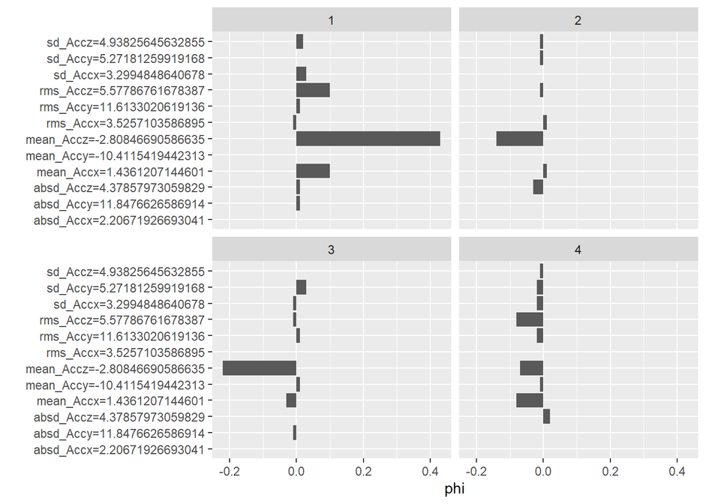
G21: Cruoglio Antonella - Iovino Giuliana - Mascolo Davide - Napoli Mario
September 14, 2022
Shapley Values
A method from coalitional game theory. The idea behind Shapley values is to assess every combination of predictors to determine each predictors impact. Focusing on feature xj, the approach will test the accuracy of every combination of features not including xj and then test how adding xj to each combination improves the accuracy.
The mean acceleration on the x-axis has a positive effect on the prediction of the subject 1 and a negative impact on the classification of the class 4.
The impact of the mean acceleration on the z-axis is high positive for the subject 1 and negative for the subject 2.

Slide 24
G21: Cruoglio Antonella - Iovino Giuliana - Mascolo Davide - Napoli Mario
September 14, 2022
It seems that only few variables have a big importance.
For this reason, we can try to train a new model, using a lower number of variables.
1
Mean of the Acceleration
on the x-axis
4
Absolute Difference of the Acceleration on the z-axis
Mean of the Acceleration
on the z-axis
Root Mean Square of the Acceleration on the z-axis
2
5
Standard Deviation of the Acceleration on the z-axis
3

Slide 25

G21: Cruoglio Antonella - Iovino Giuliana - Mascolo Davide - Napoli Mario
September 14, 2022
RF - reduced
Even if we use a lower number of features, we got a good value of accuracy = 0.9824

Slide 26

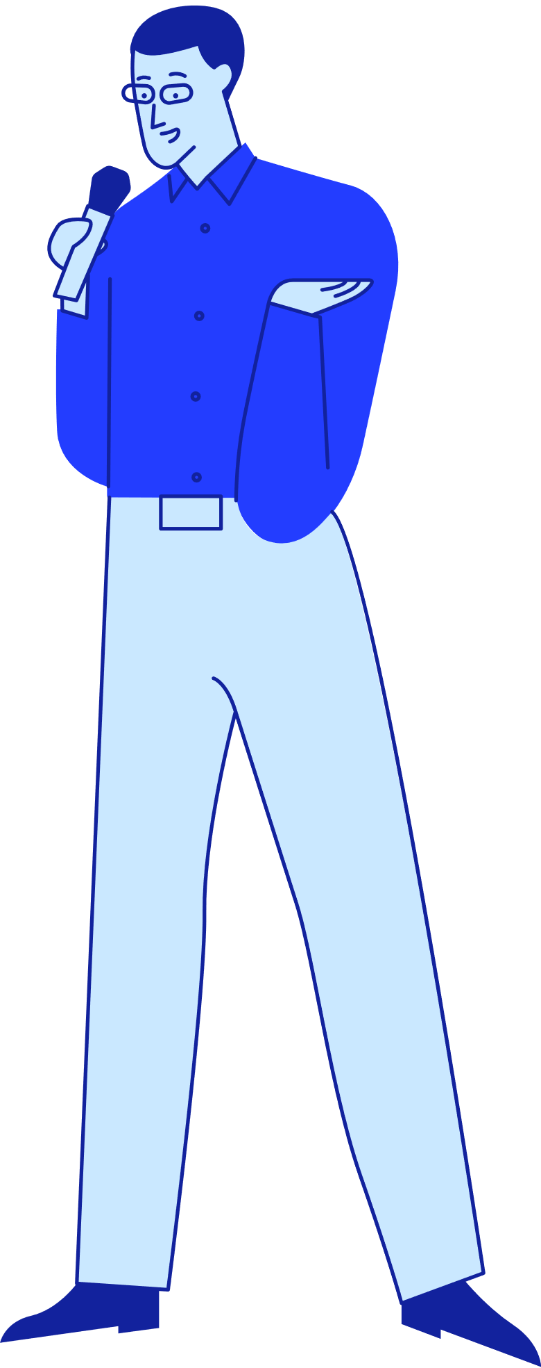
G21: Cruoglio Antonella - Iovino Giuliana - Mascolo Davide - Napoli Mario
September 14, 2022
The unsupervised way
Are you ready?

Slide 27
G21: Cruoglio Antonella - Iovino Giuliana - Mascolo Davide - Napoli Mario
September 14, 2022
We wanted to use another approach.
We removed the target variable and we used an unsupervised method in order to identify the different classes.
Clustering

Slide 28
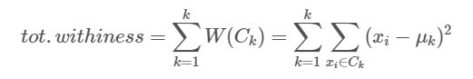
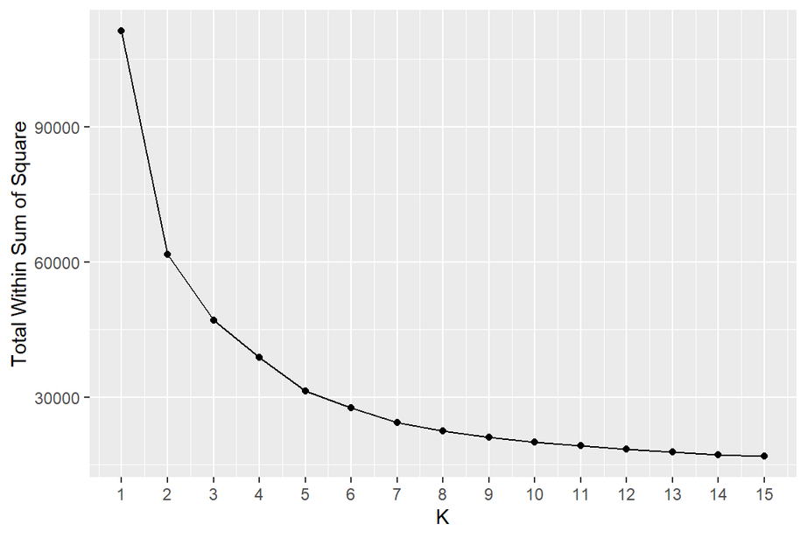
G21: Cruoglio Antonella - Iovino Giuliana - Mascolo Davide - Napoli Mario
September 14, 2022
K-means
In order to find the best number of clusters, we computed the Within Sum of Square for different numbers of K.
Looking at the plot, we suppose that the “elbow” is around K = 2 and K = 4

Slide 29
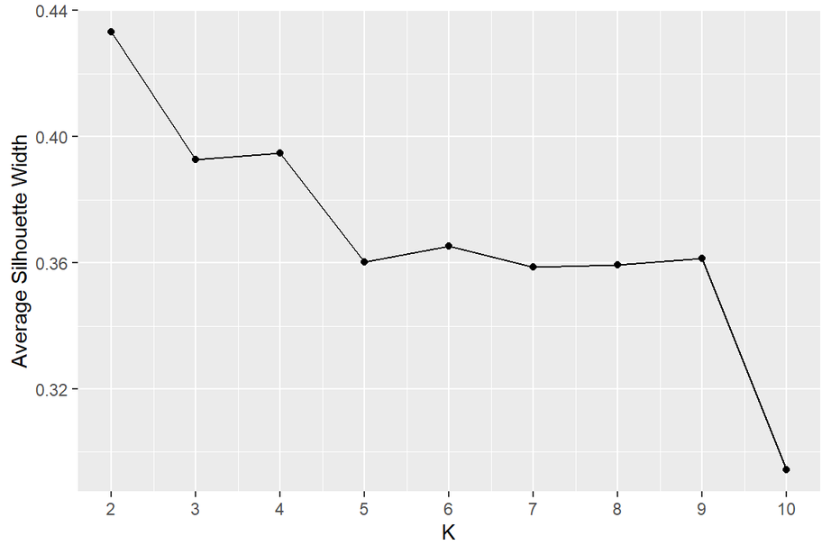
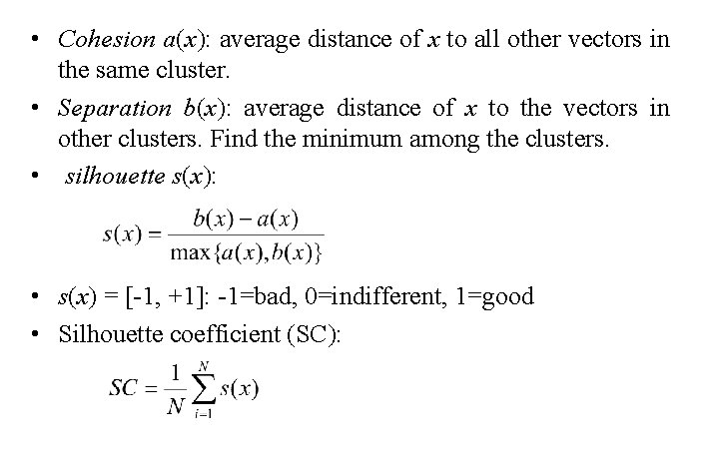
G21: Cruoglio Antonella - Iovino Giuliana - Mascolo Davide - Napoli Mario
September 14, 2022
ASW plot
The K that maximizes the Average Silhouette Width is
K = 2, followed by K = 4
Let’s see also the Average Silhouette Plot.

Slide 30
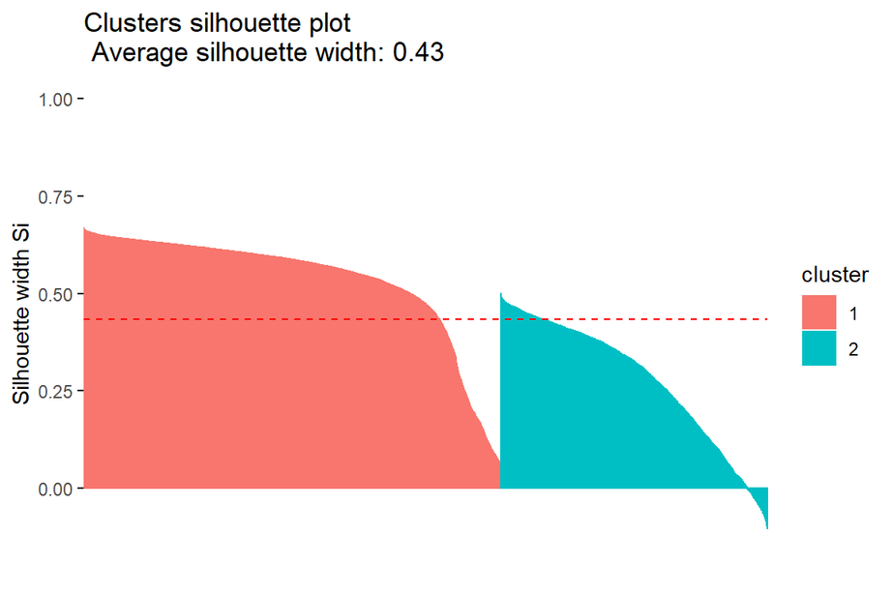
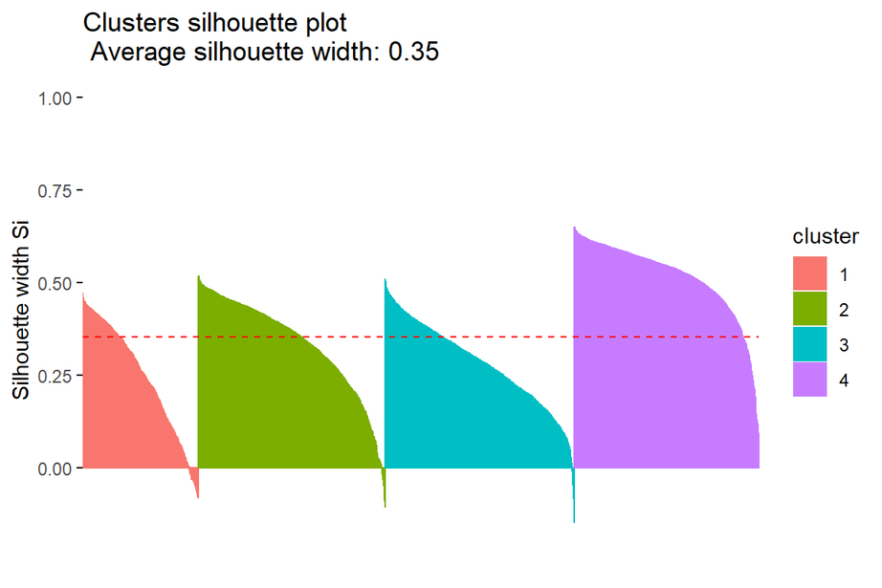
G21: Cruoglio Antonella - Iovino Giuliana - Mascolo Davide - Napoli Mario
September 14, 2022
ASW

Slide 31
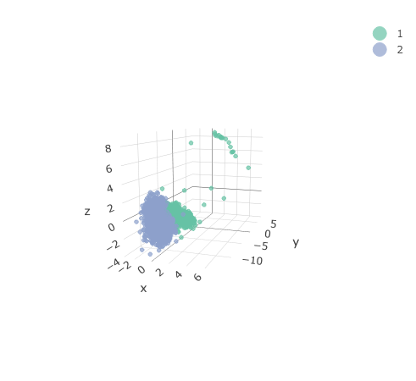
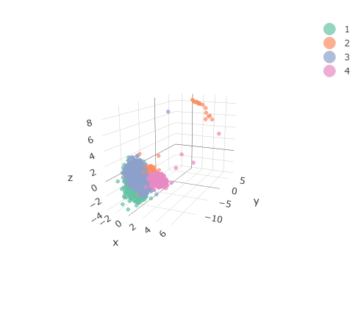
K = 2
K = 4
The primary difference in walking styles between people is caused by mean acceleration values in x-axis.
The primary difference in walking styles between people is caused by mean acceleration values in x and z axes.
Only few points differ for all the three axes.

Slide 32
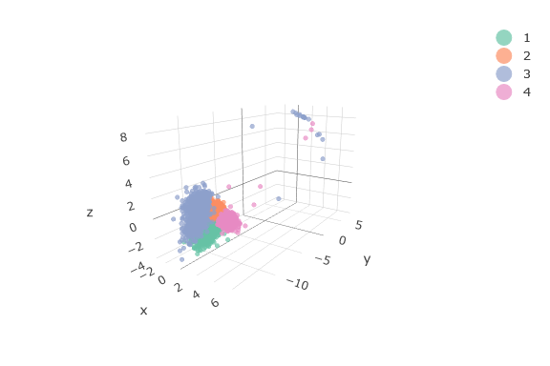
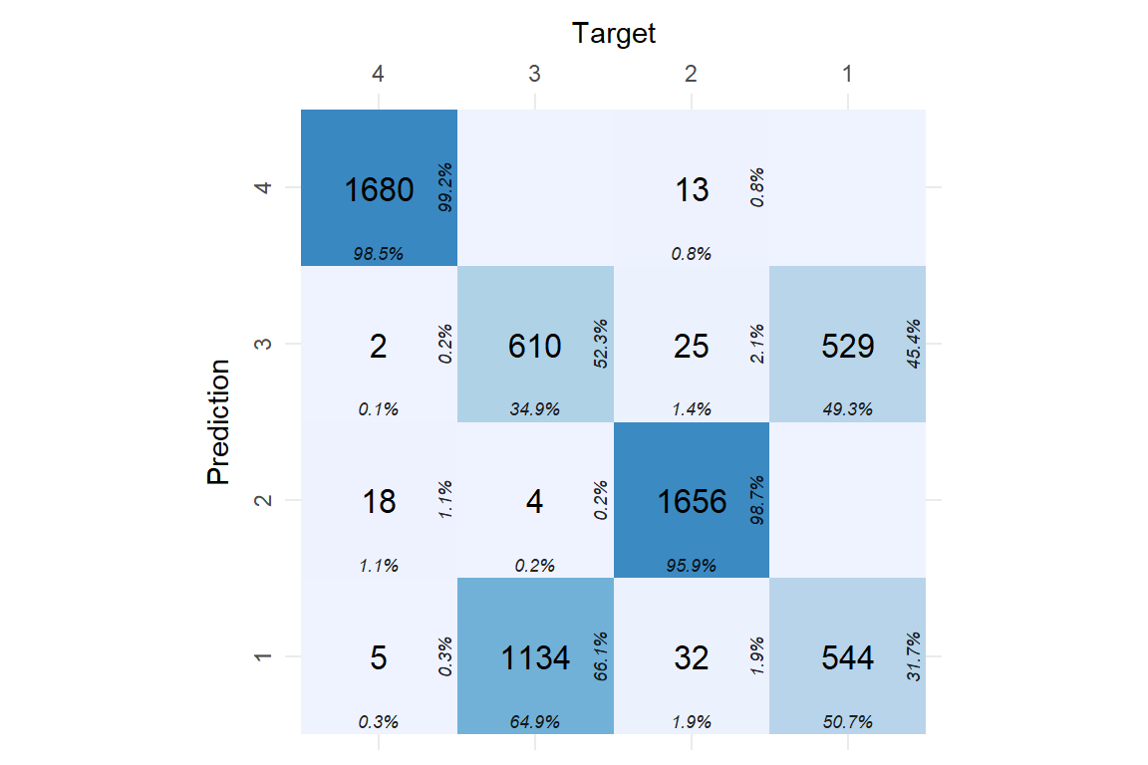
True Labels
Predicted Clusters

Slide 33
Conclusions and Future Works
The performances are excellent for all models, the best result is obtained with the random forest. The window size is relevant for the accuracy, in particular we noted that after a window size of 0.7 seconds, we had a score greater than 0.90 and after 1 second the performances were very similar to each other with good results.
Future Works
- Use a low-pass filter in order to separate the linear acceleration due to the body motion and the acceleration due to the gravity
- Dynamic allocation window size

Slide 34

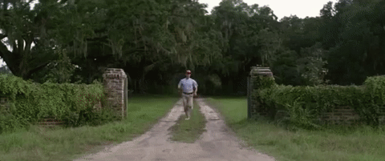
G21: Cruoglio Antonella - Iovino Giuliana - Mascolo Davide - Napoli Mario
September 14, 2022
We're done!
Thank you
for the attention

